Slide 1
Capstone Project - 4
NETFLIX MOVIES AND TV SHOWS CLUSTERING
Chetan Prakash
Pallavi Wagh

Slide 2

Content:
Introduction
Project Summary
Problem Statement
Data Description
Exploratory Data Analysis
Data Preprocessing
Model Implementation
Cluster Analysis
Conclusions

Slide 3

Introduction
Netflix, founded in 1997, is a leading global streaming service offering a wide range of movies, TV shows, documentaries, and original content. Initially a DVD rental-by-mail service, Netflix transitioned into a streaming service in 2007, allowing subscribers to stream movies and TV shows directly to their devices. The platform's extensive library caters to diverse interests and preferences, with subscribers accessing content on various devices. Netflix's success is attributed to its user-friendly interface, personalized recommendations, and convenience, allowing subscribers to binge-watch entire seasons or discover new content at their own pace. With a global reach in over 190 countries, Netflix has transformed the way people consume entertainment and become a household name synonymous with streaming and on-demand viewing.

Slide 4
Project Summary
The Netflix cluster analysis project aimed to identify trends and group similar items in a dataset containing information on films, actors, directors, genres, and countries. A methodical approach was used, including data preprocessing, feature extraction, dimension reduction, clustering algorithm selection, cluster visualization, and evaluation. The project yielded valuable insights into Netflix's dataset, enabling personalized recommendations, targeted marketing, and content classification. Further refinement and exploration of algorithms, parameters, and features are needed to improve clustering performance and provide a foundation for data-driven decision making in the entertainment industry.

Slide 5



Problem Statement
The aim is to do cluster analysis on a Netflix dataset in order to identify patterns and group similar items together. The collection contains a variety of information, including descriptions, actors, directors, types, and countries, among others. The goal is to find movie clusters based on these traits, which will allow for customized recommendations, targeted marketing, and content classification. The study aims to provide relevant insights about movie connections and to enable data-driven decision-making in the entertainment industry.

Slide 6

Data Description
The data was collected from Flixable which is third party Netflix search engine. The dataset consists of movies and TV shows data till 2021.
The dataset consists of eleven textual columns and one numeric column.
This dataset has 7787 Rows and 12 Columns.

Slide 7
Data Description
show_id : Unique ID for every Movie / Tv Show
type : Identifier - A Movie or TV Show
title : Title of the Movie / Tv Show
director : Director of the Movie
cast : Actors involved in the movie / show
country : Country where the movie / show was produced
date_added : Date it was added on Netflix
Release_year : Actual Release year of the movie / show
rating : TV Rating of the movie / show
duration : Total Duration - in minutes or number of seasons
listed_in : Genre
description: The Summary description

Slide 8
Null Value
● Director feature have more than 30.68% of null values. The null values were filled up with "Unknown".
● Country feature have 6.51% of null values. The null values were filled up with "Unknown".
● Cast feature have 9.22% of null values. The null values were filled up with "Unknown".
● Rating feature have 0.09% of null values. We removed the rows with null values. ● Date_added feature have 0.13% of null values. We removed the rows with null values.

Slide 9
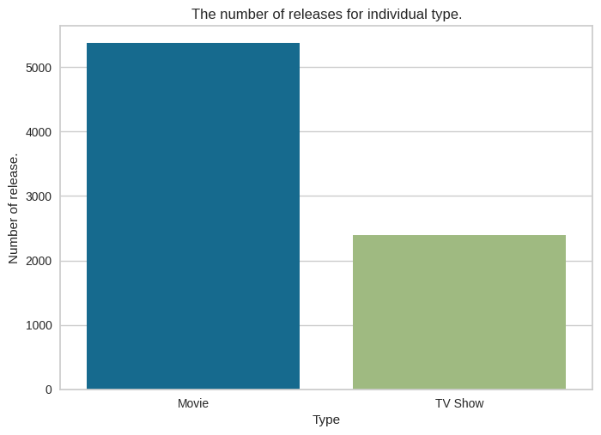
Exploratory Data Analysis
Type of content available on Netflix
•It is evident that there are more movies on Netflix than TV shows.
•Netflix has 5377 movies, which is more than double the quantity of TV shows.

Slide 10
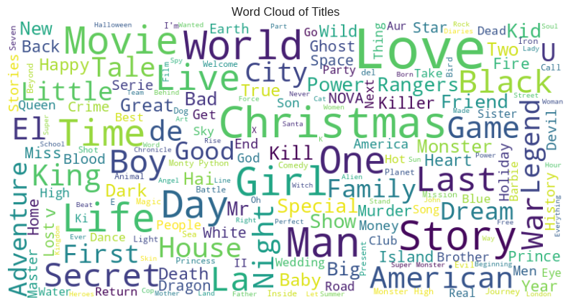
Exploratory Data Analysis
Christmas, Love, World, Man, and Story are frequently repeated in titles, indicating winter additions in films and TV series.

Slide 11
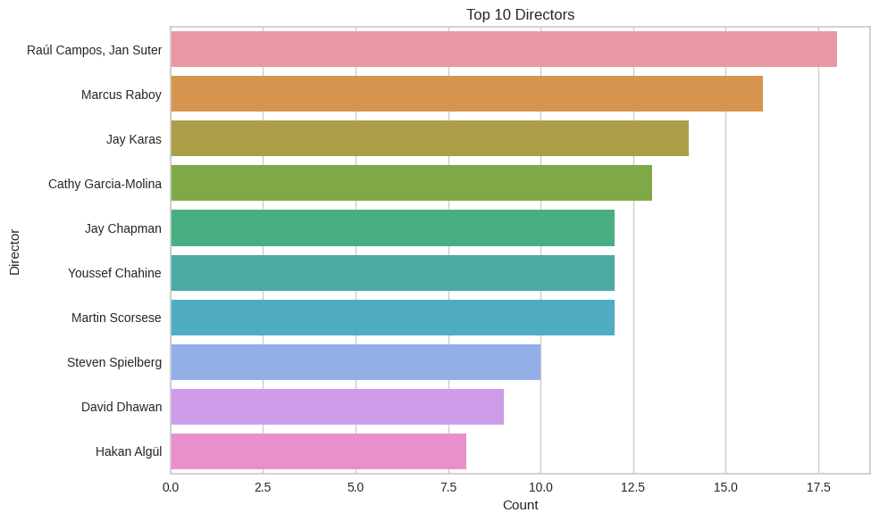
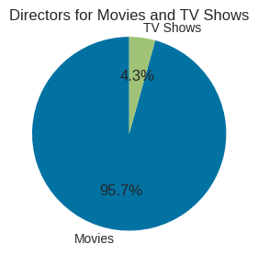
Exploratory Data Analysis
Only 4.3% of directors are associated with TV shows, whereas 95.7% are associated with films.
Jan Suter and Raul Campos have each directed 18 films or TV episodes, which is more than any other director in the dataset.

Slide 12
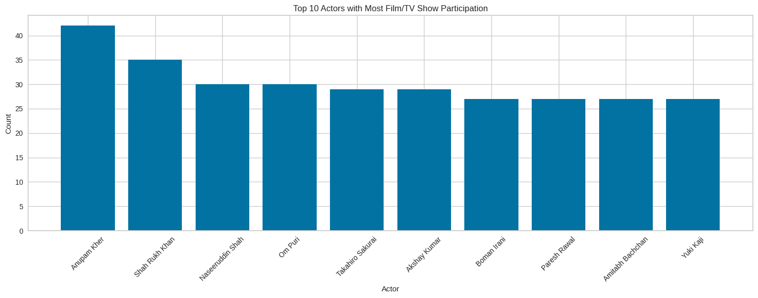
Exploratory Data Analysis
There are 6831 actors who participate in the movies or TV Shows.
The most frequently featured actors are Anupam Kher, Shahrukh Khan, and Om Puri.

Slide 13
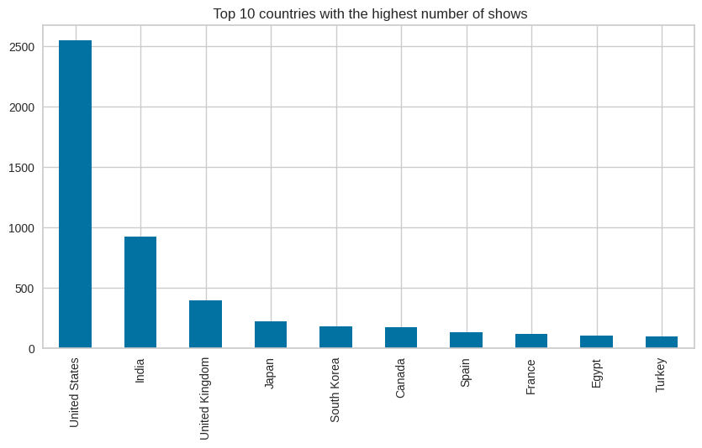
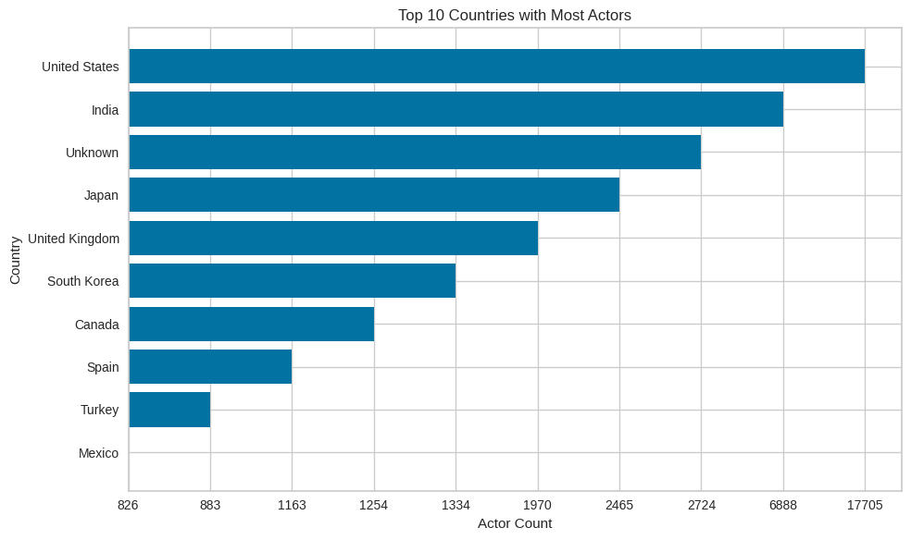
Exploratory Data Analysis
The US has the most TV shows and movie programs in the dataset. followed by India and the UK respectively.
51% of total content is produced by US, India and UK.
Maximum number of actors featured are from US followed by India.

Slide 14
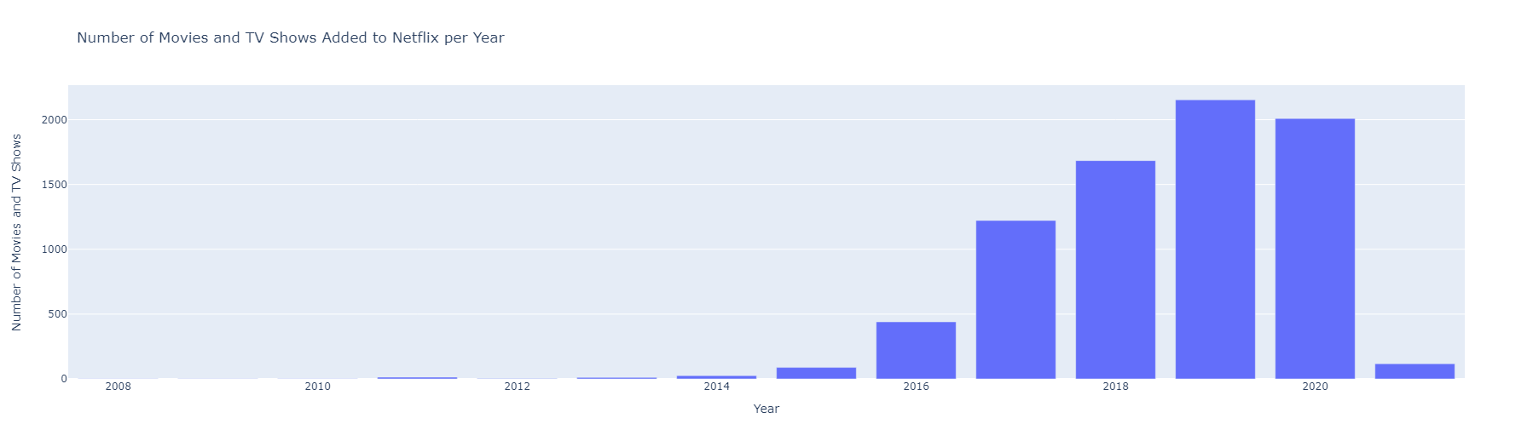
Exploratory Data Analysis
Data is showing releases between 2008 to 2021.
In 2019, the most content was added.

Slide 15
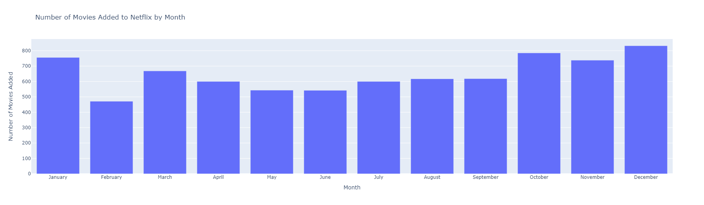
Exploratory Data Analysis
Maximum number of movies and tv shows were released over the winter especially in the month of December.

Slide 16
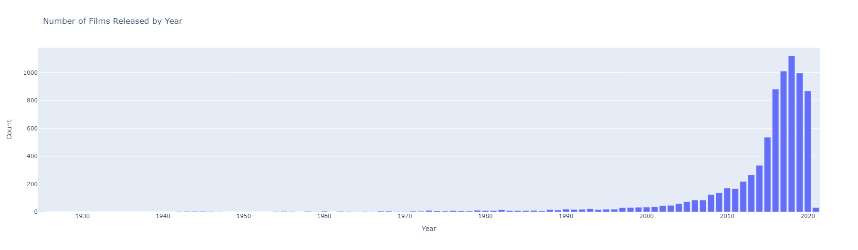
Exploratory Data Analysis
The release years for films in the collection range from 1925 to 2021.
We are able to see that there has been a huge increase in content releases between 2010 and 2020.

Slide 17
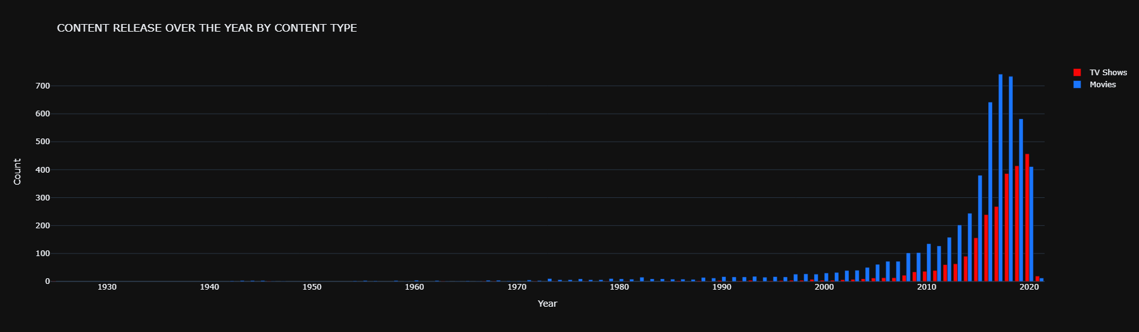
Exploratory Data Analysis
In 2017, the most films were released—742 in total.
In 2020, the most TV Shows were released- 457 in total.

Slide 18
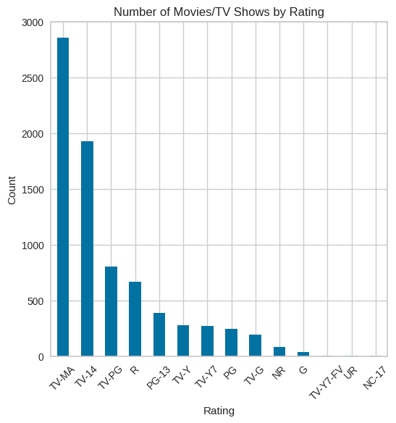
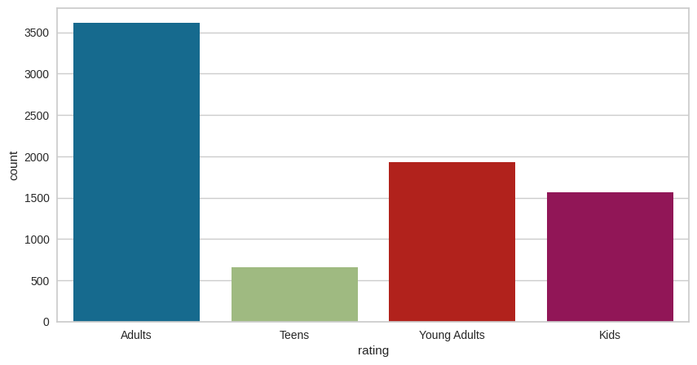
Exploratory Data Analysis
Maximum content falls under TV-MA rating followed by TV-14 and TV-PG Ratings.
Around 50% of shows on Netflix are produced for an adult audience. Followed by young adults and kids. Netflix has fewer shows that are specifically produced for teenagers than other age groups.

Slide 19
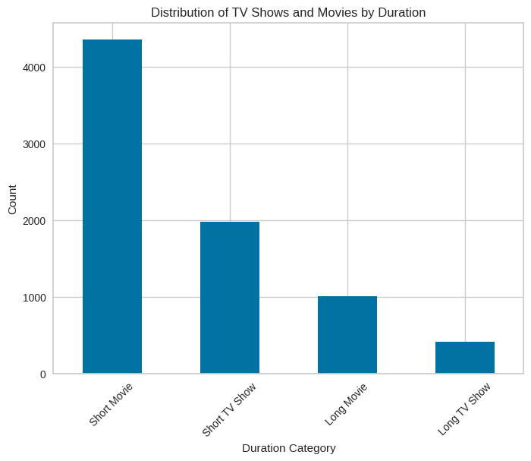
Exploratory Data Analysis
Short Movies: A little over 56.1% of Netflix's programming is made up of films that are under 120 minutes long.
TV shows: With fewer than two seasons make up about 25.6% of the programming on Netflix.
Long Films: Approximately 13% of Netflix's programming consists of films that are longer than 120 minutes.
Long TV Shows: About 5.39% of Netflix's programming consists of TV series that have more than two seasons.

Slide 20
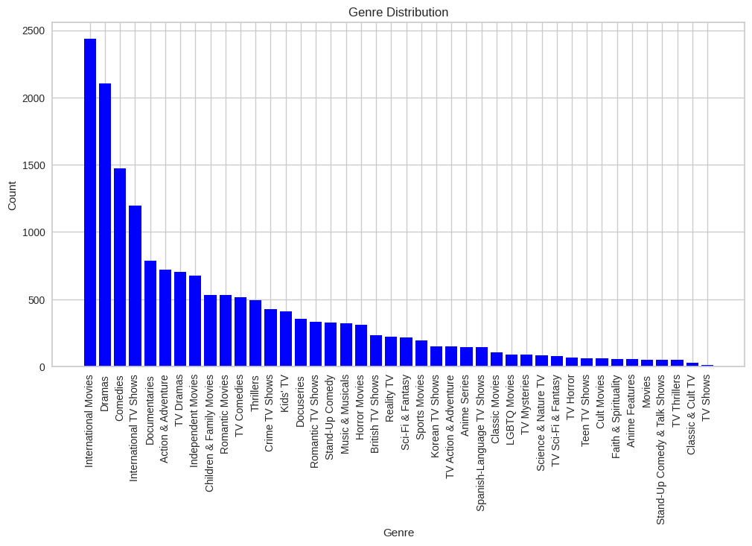
Exploratory Data Analysis
Most countries appear to prefer dramas, international movies, and comedies.

Slide 21
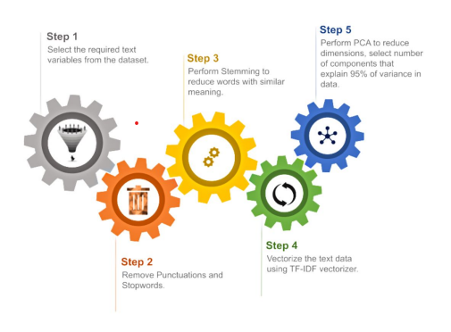
Data Preprocessing.

Slide 22
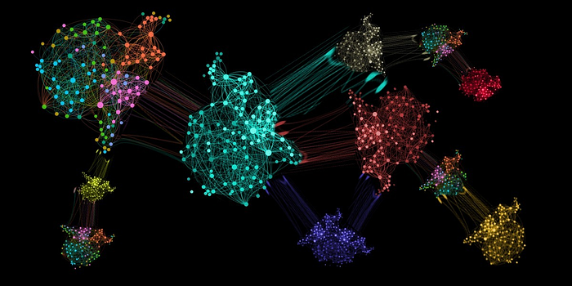
What is clustering?
Clustering is the process of grouping data points so that data points in the same group are more similar to other data points in the same group and different to data points in other groups. It is essentially a collection of items based on their similarity and dissimilarity.
We create one cluster column based on the following features:
• Director
• Cast
• Country
• Rating
• Listed in (genres)
• Description

Slide 23
Before clusters implementation we need to pre-process the data. So that we filtered data with following steps:
Removing Stop words
• Stop words are common words like “the”, “and” and “but” do not carry much meaning on their own and are often seen as noise in the data.
2. Lowercasing words
• Lowercasing the words can also reduce the size of the vocabulary, which can make it easier to work with larger texts or texts in languages with a high number of inflected forms.
3. Removing Punctuation
• Punctuation marks like periods, commas, and exclamation points can add noise to the data and can sometimes be treated as separate tokens, which can affect the performance of NLP models.
4. Stemming
• used Snowball Stemmer to generate a meaningful word out of corpus of words.
• For example, the words "run," "runs," "ran," and "running" are all different inflected forms of the same word "run," and a stemmer can reduce them all to the base form "run."
5. Tokenization of corpus and Word vectorization – TFIDF
This is important in NLP tasks because most machine learning models expect numerical input and cannot work with raw text data directly. Word vectorization allows you to input the words into a machine learning model in a way that preserves the meaning and context of the words.
6. Dimensionality reduction – PCA
• Dimensionality reduction is the process of reducing the number of features or dimensions in a dataset while preserving as much information as possible. As high-dimensional datasets can be difficult to work with and can sometimes suffer from the curse of dimensionality.

Slide 24
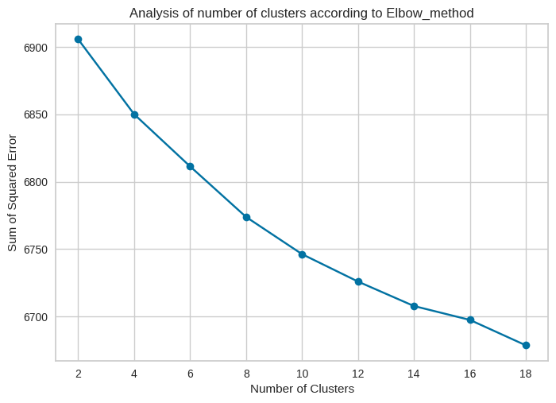
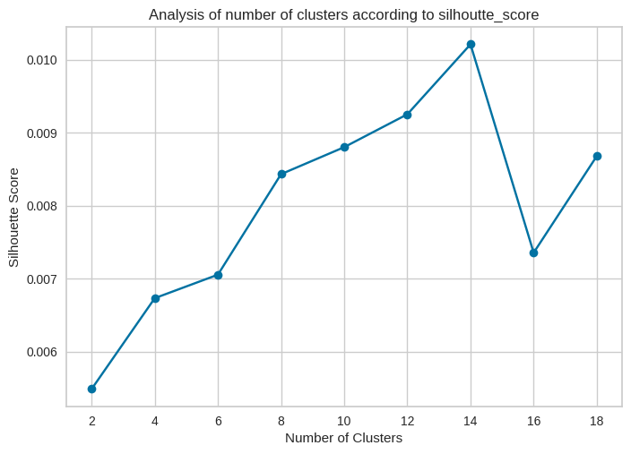
Model Implementation
k-means clustering
Visualizing the elbow curve and Silhouette score to decide on the optimal number of clusters for K-means clustering algorithm.
Using the Silhouette Score and Elbow Method we select the optimal number of clusters to be 9.

Slide 25
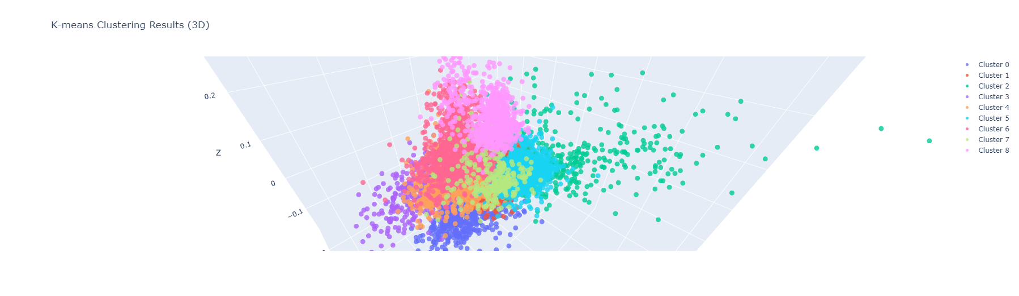
The numbers 0 to 8 represent 9-distinct clusters formed by K-means clustering.
Each cluster contains data points similar to those in the same groups but varies from other groups.

Slide 26
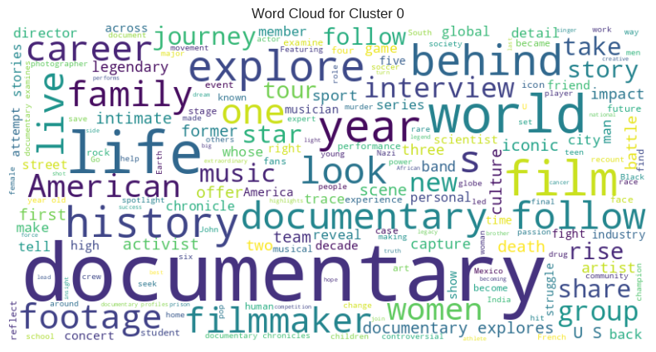
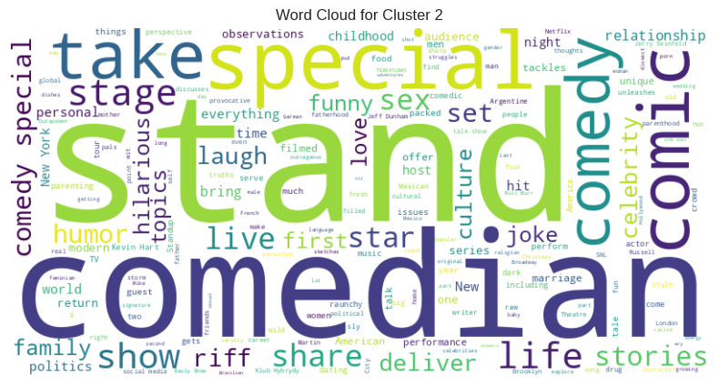
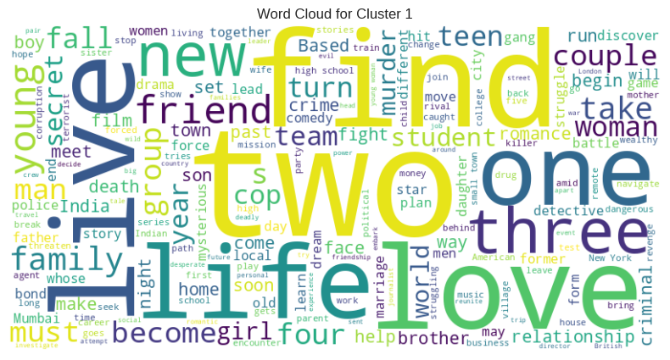
Data represented by each cluster
Drama, Horror
Cluster - 1
Stand-Up Comedy Show
Cluster - 0
Kid's TV, Anime
Cluster - 2

Slide 27
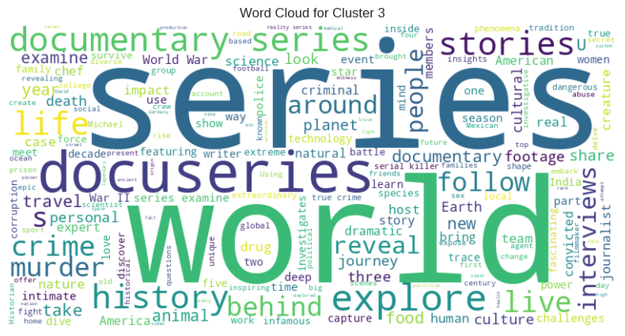
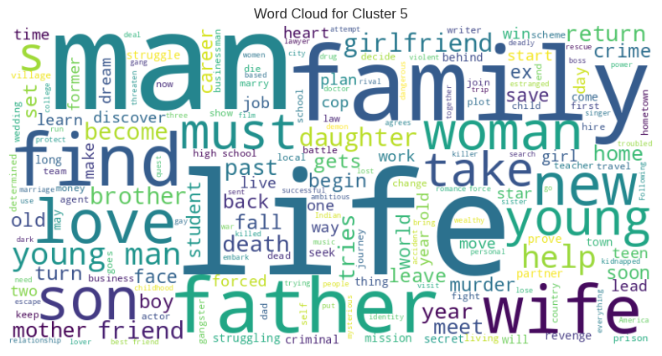
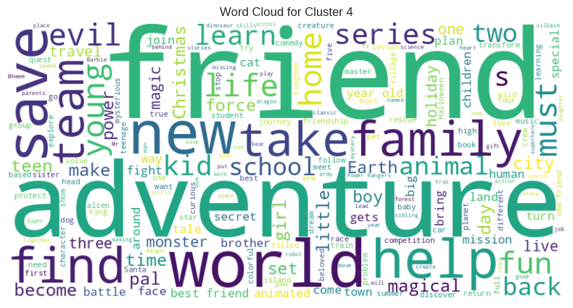
Data represented by each cluster
International TV Shows, Drama
Cluster - 4
Documentaries, Sports, International, Music and Musicals
Cluster - 3
Children and Family Movies
Cluster - 5

Slide 28
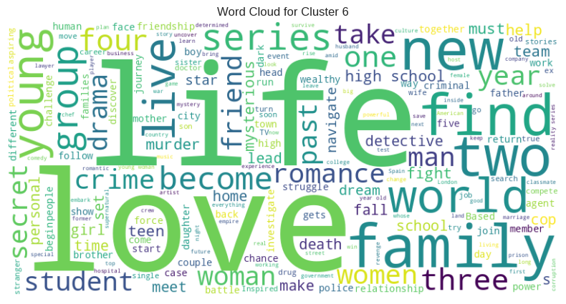
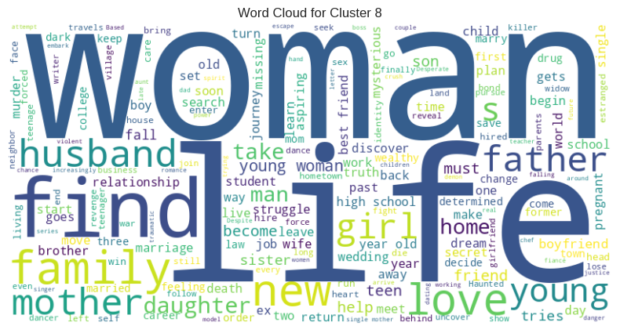
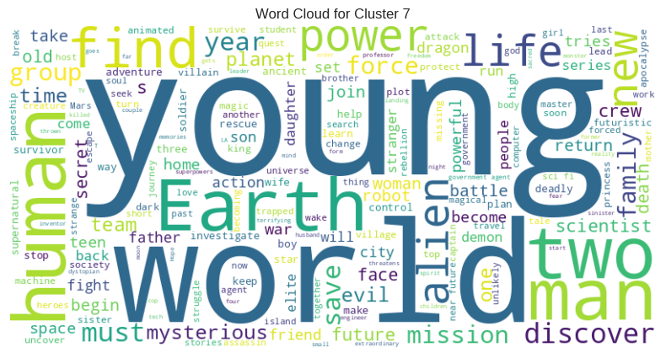
Data represented by each cluster
Comedies, Romantic Movies
Cluster - 7
Action and Adventures, Sci-Fi and Fantasy
Cluster - 6
Docuseries, Reality TV
Cluster - 8

Slide 29
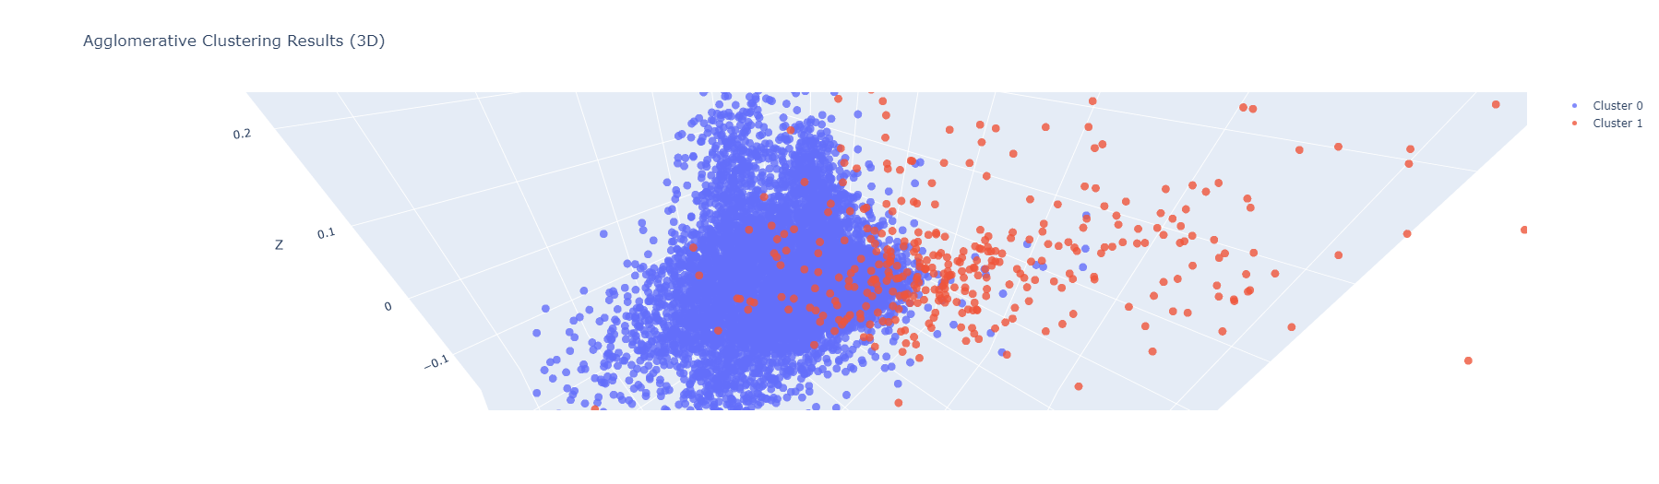
Agglomerative Hierarchical Clustering
The numbers 0 and 1 represent 2-distinct clusters formed by K-means clustering.
Each cluster contains data points similar to those in the same groups but varies from other groups.

Slide 30
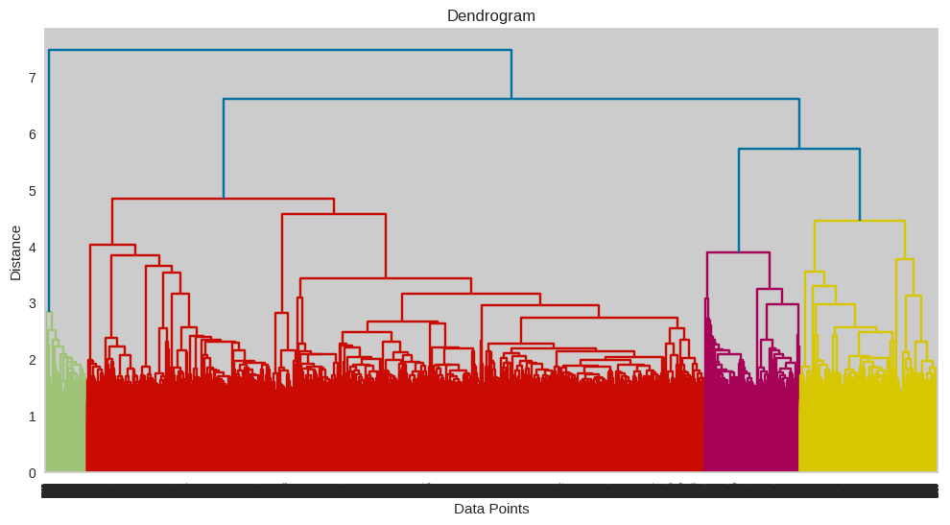
Agglomerative Hierarchical Clustering
• Visualizing the dendrogram to decide on the optimal number of clusters for the agglomerative (hierarchical) clustering algorithm.
• 2 clusters can be built using the agglomerative clustering algorithm.

Slide 31
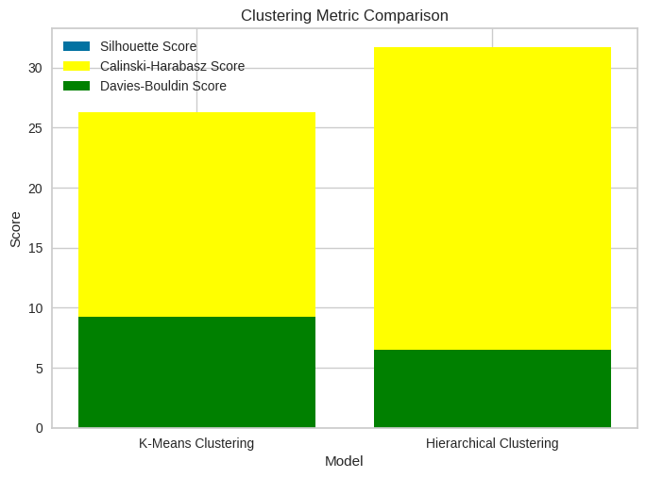
Final Prediction Model
Taking all of these assessment factors into consideration, Hierarchical Clustering appears as the best option. Its higher Calinski-Harabasz score implies stronger cluster separation, while its lower Davies-Bouldin score shows well-defined clusters with less overlap. While K-Means Clustering has a higher silhouette score, Hierarchical Clustering has a better overall performance.

Slide 32
Conclusion
Netflix's cluster analysis utilized unsupervised learning algorithms like K-means and Agglomerative clustering to group similar movies based on features like descriptions, cast members, directors, genres, and countries. The results provided valuable insights for personalized recommendations and targeted marketing strategies. The Silhouette Score, Calinski-Harabasz Score, and Davies-Bouldin Score assessed the clustering models' quality and effectiveness, contributing to data-driven decision making in the entertainment industry.
CONCLUSION FROM EDA:
The frequently featured actors are Anupam Kher, Shahrukh Khan, and Om Puri.
The most material was released in 2019, with the most films and TV episodes released in December.
Approximately half of the shows on Netflix are produced for adult audiences with a TV-MA rating being the most popular
There is a significant increase in content release from 2010 to 2020.
The most films, 1120, were released in 2018, and the most TV shows, 457, were released in 2020.
The United States, India, and the United Kingdom create 51% of the total content.
Maximum programming is composed of content lasting less than 120 minutes.
.

Slide 33
CONCLUSION FROM MODEL IMPLEMENTATION:
The data is clustered based on the attributes: director, cast, country, genre, rating, and description.
The TFIDF vectorizer was used to tokenize, preprocess, and vectorize the data in these attributes.
The data dimensionality, which formed the majority of the variation, was reduced using Principal Component Analysis (PCA).
The K-Means Clustering algorithm was used to create clusters, with 9 being the optimum number based on the elbow technique and Silhouette score analysis.
The agglomerative clustering technique was used to create clusters, with the dendrogram visualisation indicating that 2 clusters were optimum.
Hierarchical Clustering has a better overall performance.

Slide 34
Thank you

